Slide 1
Chapter 11 - Graphics and Java 2D
Outline
11.1 Introduction
11.2 Graphics Contexts and Graphics Objects
11.3 Color Control
11.4 Font Control
11.5 Drawing Lines, Rectangles and Ovals
11.6 Drawing Arcs
11.7 Drawing Polygons and Polylines
11.8 The Java 2D API
11.9 Java 2D Shapes
11.10 (Optional Case Study) Thinking About Objects: Designing Interfaces with the UML

Slide 2
11.1 Introduction
Java’s graphics capabilities
  Drawing 2D shapes
  Controlling colors
  Controlling fonts
Java 2D API
  More sophisticated graphics capabilities
    Drawing custom 2D shapes
    Filling shapes with colors and patterns

Slide 3
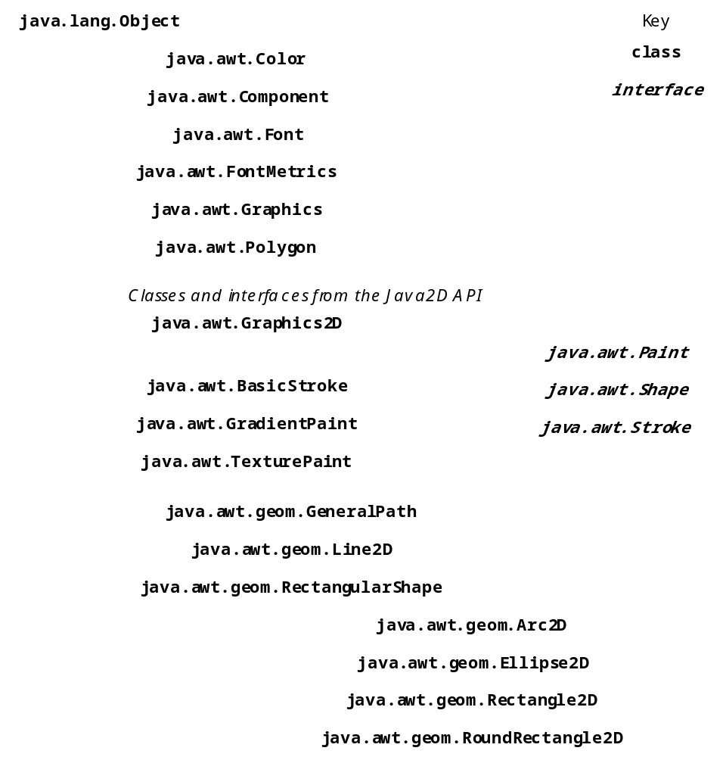
Fig 11.1 Some classes and interfaces used in this chapter from Java’s original graphics capabilities and from the Java2D API

Slide 4
11.1 Introduction
Java’s coordinate system
  Scheme for identifying all points on screen
  Upper-left corner has coordinates (0,0)
  Coordinate point composed of x-coordinate and y-coordinate

Slide 5
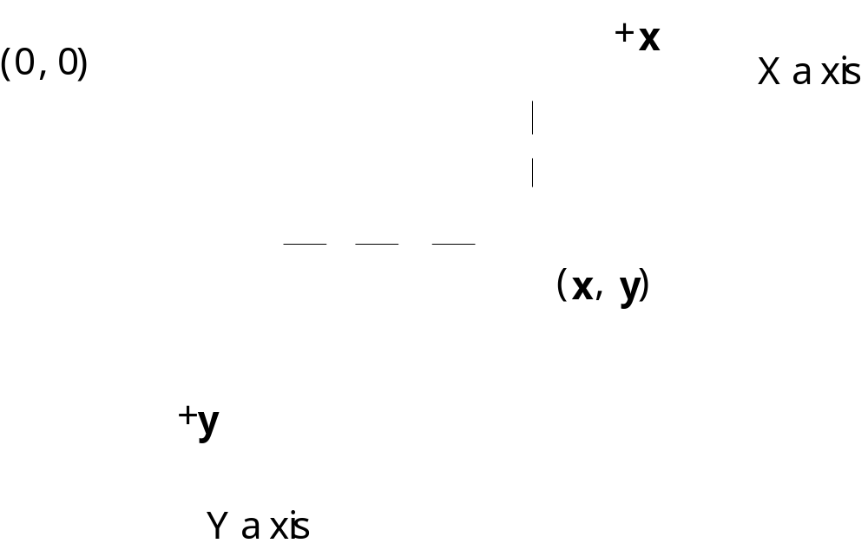
Fig. 11.2 Java coordinate system. Units are measured in pixels.

Slide 6
11.2 Graphics Context and Graphics Objects
Graphics context
  Enables drawing on screen
  Graphics object manages graphics context
    Controls how information is drawn
  Class Graphics is abstract
    Cannot be instantiated
    Contributes to Java’s portability
  Class Component method paint takes Graphics object
  public void paint( Graphics g )
  Called through method repaint

Slide 7
11.3 Color Control
Class Color
  Defines methods and constants for manipulating colors
  Colors are created from red, green and blue components
    RGB values

Slide 8
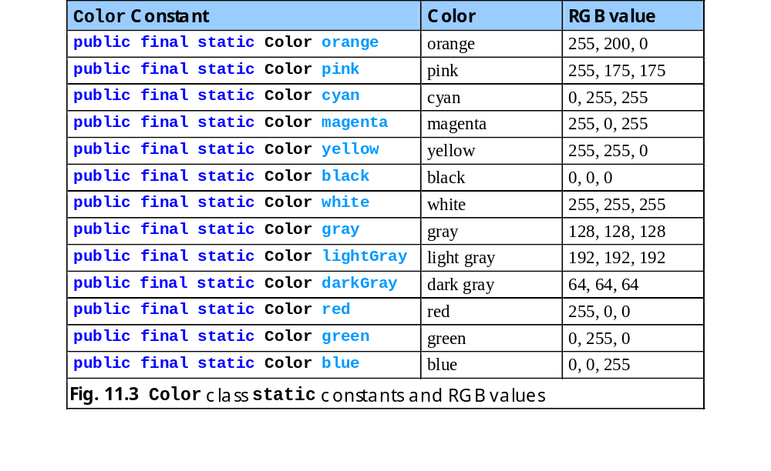
Fig. 11.3 Color class static constants and RGB values.

Slide 9
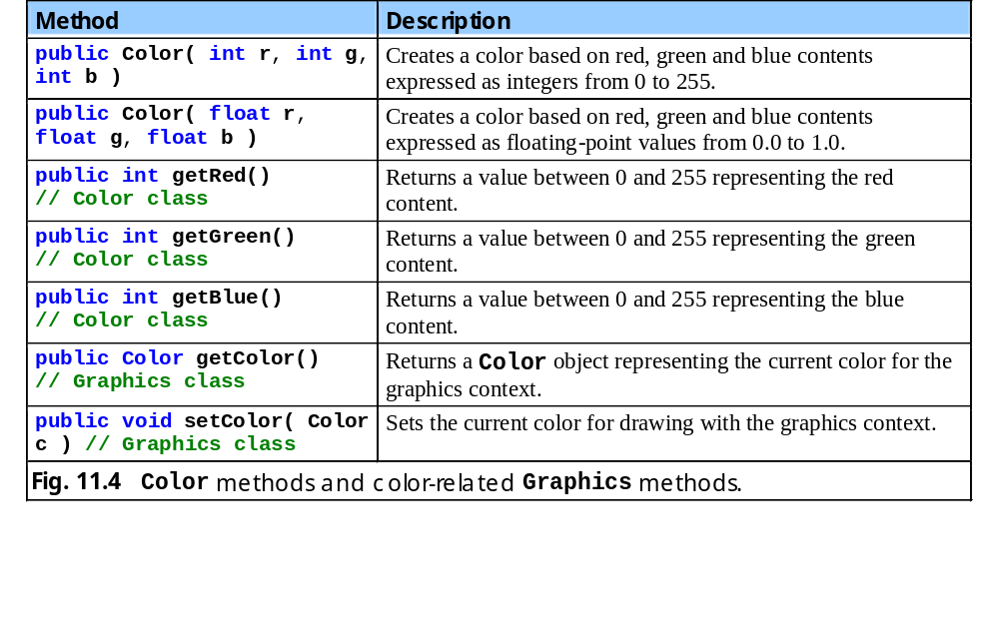
Fig. 11.4 Color methods and color-related Graphics methods.

Slide 10
1 // Fig. 11.5: ShowColors.java
2 // Demonstrating Colors.
3
4 // Java core packages
5 import java.awt.*;
6 import java.awt.event.*;
7
8 // Java extension packages
9 import javax.swing.*;
10
11 public class ShowColors extends JFrame {
12
13 // constructor sets window's title bar string and dimensions
14 public ShowColors()
15 {
16 super( "Using colors" );
17
18 setSize( 400, 130 );
19 setVisible( true );
20 }
21
22 // draw rectangles and Strings in different colors
23 public void paint( Graphics g )
24 {
25 // call superclass's paint method
26 super.paint( g );
27
28 // set new drawing color using integers
29 g.setColor( new Color( 255, 0, 0 ) );
30 g.fillRect( 25, 25, 100, 20 );
31 g.drawString( "Current RGB: " + g.getColor(), 130, 40 );
32
33 // set new drawing color using floats
34 g.setColor( new Color( 0.0f, 1.0f, 0.0f ) );
35 g.fillRect( 25, 50, 100, 20 );
ShowColors.java
Line 23
Line 29
Line 30
Line 31
Paint window when application begins execution
Method setColor sets color’s RGB value
Method fillRect creates filled rectangle at specified coordinates using current RGB value
Method drawString draw colored text at specified coordinates

Slide 11
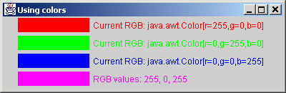
36 g.drawString( "Current RGB: " + g.getColor(), 130, 65 );
37
38 // set new drawing color using static Color objects
39 g.setColor( Color.blue );
40 g.fillRect( 25, 75, 100, 20 );
41 g.drawString( "Current RGB: " + g.getColor(), 130, 90 );
42
43 // display individual RGB values
44 Color color = Color.magenta;
45 g.setColor( color );
46 g.fillRect( 25, 100, 100, 20 );
47 g.drawString( "RGB values: " + color.getRed() + ", " +
48 color.getGreen() + ", " + color.getBlue(), 130, 115 );
49 }
50
51 // execute application
52 public static void main( String args[] )
53 {
54 ShowColors application = new ShowColors();
55
56 application.setDefaultCloseOperation(
57 JFrame.EXIT_ON_CLOSE );
58 }
59
60 } // end class ShowColors
ShowColors.java
Lines 39 and 44
Use constant in class Color to specify current color

Slide 12
1 // Fig. 11.6: ShowColors2.java
2 // Demonstrating JColorChooser.
3
4 // Java core packages
5 import java.awt.*;
6 import java.awt.event.*;
7
8 // Java extension packages
9 import javax.swing.*;
10
11 public class ShowColors2 extends JFrame {
12 private JButton changeColorButton;
13 private Color color = Color.lightGray;
14 private Container container;
15
16 // set up GUI
17 public ShowColors2()
18 {
19 super( "Using JColorChooser" );
20
21 container = getContentPane();
22 container.setLayout( new FlowLayout() );
23
24 // set up changeColorButton and register its event handler
25 changeColorButton = new JButton( "Change Color" );
26
27 changeColorButton.addActionListener(
28
29 // anonymous inner class
30 new ActionListener() {
31
32 // display JColorChooser when user clicks button
33 public void actionPerformed( ActionEvent event )
34 {
35 color = JColorChooser.showDialog(
ShowColors2.java
Line 35
Line 35
JColorChooser allows user to choose from among several colors
static method showDialog displays the color chooser dialog

Slide 13
36 ShowColors2.this, "Choose a color", color );
37
38 // set default color, if no color is returned
39 if ( color == null )
40 color = Color.lightGray;
41
42 // change content pane's background color
43 container.setBackground( color );
44 }
45
46 } // end anonymous inner class
47
48 ); // end call to addActionListener
49
50 container.add( changeColorButton );
51
52 setSize( 400, 130 );
53 setVisible( true );
54 }
55
56 // execute application
57 public static void main( String args[] )
58 {
59 ShowColors2 application = new ShowColors2();
60
61 application.setDefaultCloseOperation(
62 JFrame.EXIT_ON_CLOSE );
63 }
64
65 } // end class ShowColors2
ShowColors2.java

Slide 14
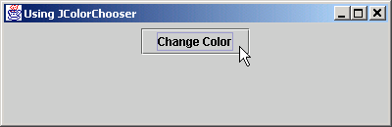
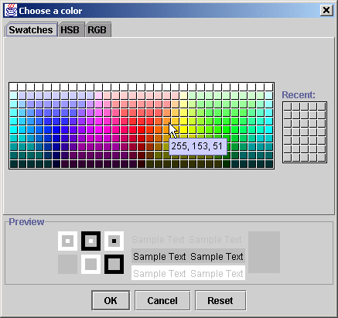
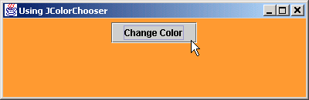
ShowColors2.java

Slide 15
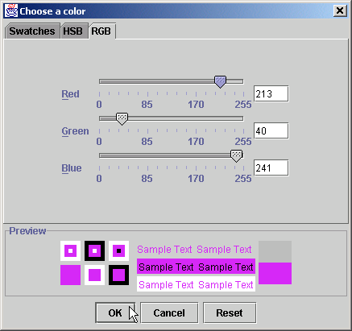
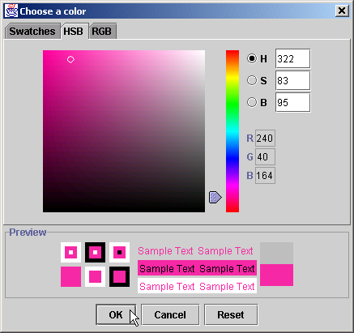
Fig. 11.7 The HSB and RGB of the JColorChooser dialog

Slide 16
11.4 Font Control
Class Font
  Contains methods and constants for font control
  Font constructor takes three arguments
    Font name
      Monospaced, SansSerif, Serif, etc.
    Font style
      Font.PLAIN, Font.ITALIC and Font.BOLD
    Font size
      Measured in points (1/72 of inch)

Slide 17
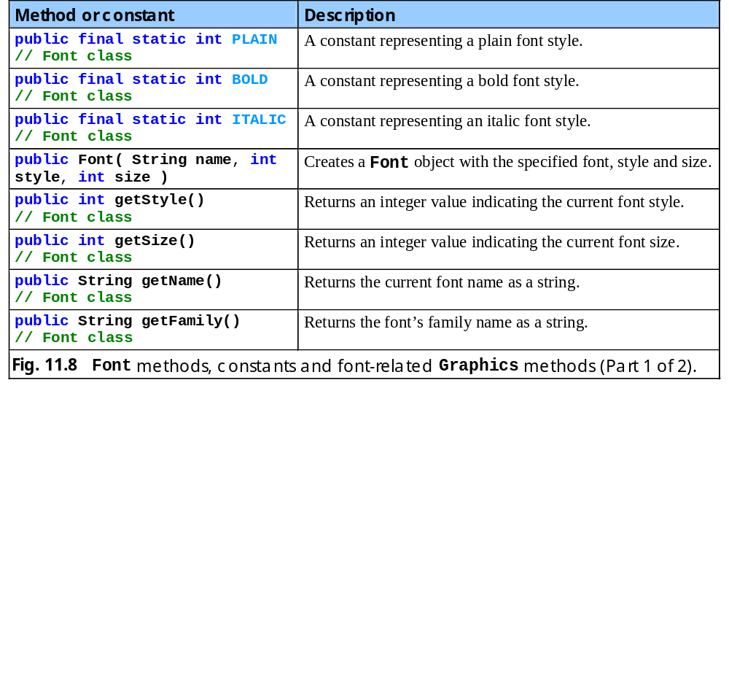
Fig. 11.8 Font methods, constants and font-related Graphics methods

Slide 18
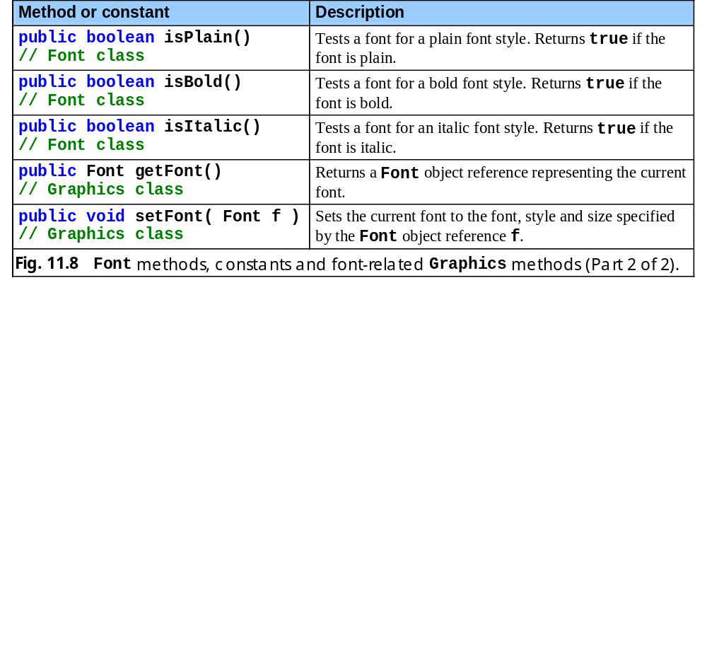
Fig. 11.8 Font methods, constants and font-related Graphics methods (Part 2).

Slide 19
1 // Fig. 11.9: Fonts.java
2 // Using fonts
3
4 // Java core packages
5 import java.awt.*;
6 import java.awt.event.*;
7
8 // Java extension packages
9 import javax.swing.*;
10
11 public class Fonts extends JFrame {
12
13 // set window's title bar and dimensions
14 public Fonts()
15 {
16 super( "Using fonts" );
17
18 setSize( 420, 125 );
19 setVisible( true );
20 }
21
22 // display Strings in different fonts and colors
23 public void paint( Graphics g )
24 {
25 // call superclass's paint method
26 super.paint( g );
27
28 // set current font to Serif (Times), bold, 12pt
29 // and draw a string
30 g.setFont( new Font( "Serif", Font.BOLD, 12 ) );
31 g.drawString( "Serif 12 point bold.", 20, 50 );
32
33 // set current font to Monospaced (Courier),
34 // italic, 24pt and draw a string
35 g.setFont( new Font( "Monospaced", Font.ITALIC, 24 ) );
Fonts.java
Line 30
Line 31
Method setFont sets current font
Draw text using current font

Slide 20
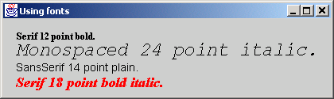
36 g.drawString( "Monospaced 24 point italic.", 20, 70 );
37
38 // set current font to SansSerif (Helvetica),
39 // plain, 14pt and draw a string
40 g.setFont( new Font( "SansSerif", Font.PLAIN, 14 ) );
41 g.drawString( "SansSerif 14 point plain.", 20, 90 );
42
43 // set current font to Serif (times), bold/italic,
44 // 18pt and draw a string
45 g.setColor( Color.red );
46 g.setFont(
47 new Font( "Serif", Font.BOLD + Font.ITALIC, 18 ) );
48 g.drawString( g.getFont().getName() + " " +
49 g.getFont().getSize() +
50 " point bold italic.", 20, 110 );
51 }
52
53 // execute application
54 public static void main( String args[] )
55 {
56 Fonts application = new Fonts();
57
58 application.setDefaultCloseOperation(
59 JFrame.EXIT_ON_CLOSE );
60 }
61
62 } // end class Fonts
Fonts.java
Line 41
Lines 46-47
Set font to SansSerif 14-point plain
Set font to Serif 18-point bold italic

Slide 21
11.4 Font Control (cont.)
Font metrics
  Height
  Descent (amount character dips below baseline)
  Ascent (amount character rises above baseline)
  Leading (difference between descent and ascent)

Slide 22
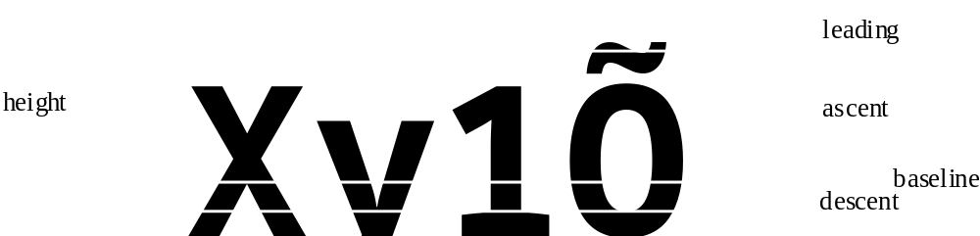
Fig. 11.10 Font metrics

Slide 23
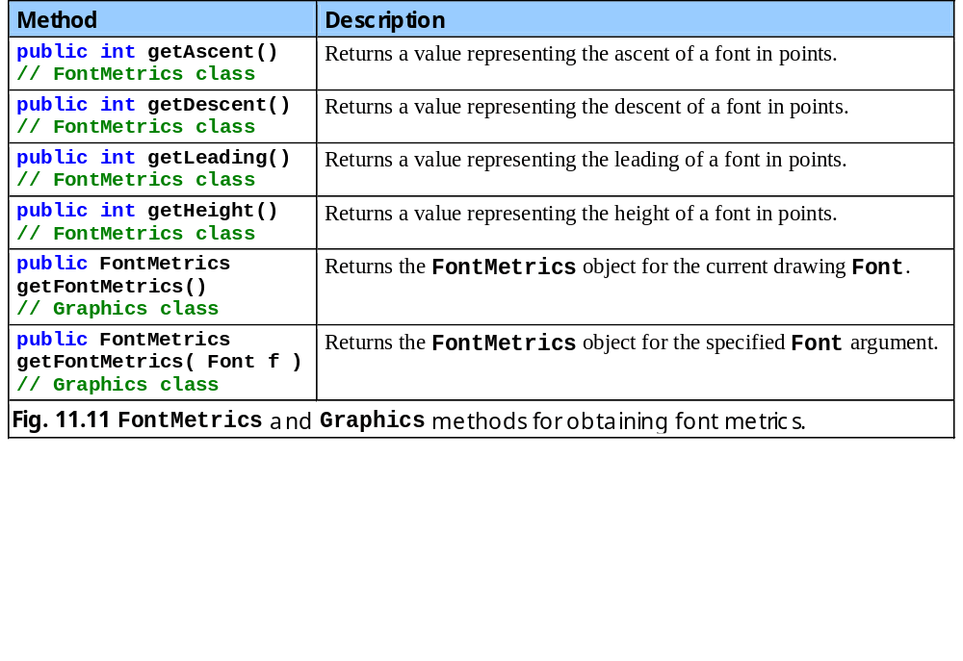
Fig. 11.11 FontMetrics and Graphics methods for obtaining font metrics.

Slide 24
1 // Fig. 11.12: Metrics.java
2 // Demonstrating methods of class FontMetrics and
3 // class Graphics useful for obtaining font metrics.
4
5 // Java core packages
6 import java.awt.*;
7 import java.awt.event.*;
8
9 // Java extension packages
10 import javax.swing.*;
11
12 public class Metrics extends JFrame {
13
14 // set window's title bar String and dimensions
15 public Metrics()
16 {
17 super( "Demonstrating FontMetrics" );
18
19 setSize( 510, 210 );
20 setVisible( true );
21 }
22
23 // display font metrics
24 public void paint( Graphics g )
25 {
26 // call superclass's paint method
27 super.paint( g );
28
29 g.setFont( new Font( "SansSerif", Font.BOLD, 12 ) );
30 FontMetrics metrics = g.getFontMetrics();
31 g.drawString( "Current font: " + g.getFont(), 10, 40 );
32 g.drawString( "Ascent: " + metrics.getAscent(), 10, 55 );
33 g.drawString( "Descent: " + metrics.getDescent(), 10, 70 );
34 g.drawString( "Height: " + metrics.getHeight(), 10, 85 );
35 g.drawString( "Leading: " + metrics.getLeading(), 10, 100);
Metrics.java
Line 29
Line 30
Lines 32-35
Set font to SansSerif 12-point bold
Obtain FontMetrics object for current font
Use FontMetrics to obtain ascent, descent, height and leading

Slide 25
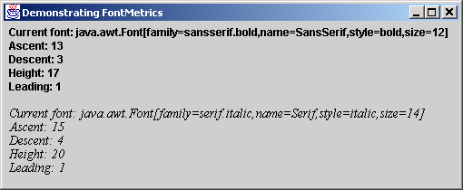
36
37 Font font = new Font( "Serif", Font.ITALIC, 14 );
38 metrics = g.getFontMetrics( font );
39 g.setFont( font );
40 g.drawString( "Current font: " + font, 10, 130 );
41 g.drawString( "Ascent: " + metrics.getAscent(), 10, 145 );
42 g.drawString( "Descent: " + metrics.getDescent(), 10, 160);
43 g.drawString( "Height: " + metrics.getHeight(), 10, 175 );
44 g.drawString( "Leading: " + metrics.getLeading(), 10, 190);
45 }
46
47 // execute application
48 public static void main( String args[] )
49 {
50 Metrics application = new Metrics();
51
52 application.setDefaultCloseOperation(
53 JFrame.EXIT_ON_CLOSE );
54 }
55
56 } // end class Metrics
Repeat same process for Serif 14-point italic font
Metrics.java
Lines 37-44

Slide 26
11.5 Drawing Lines, Rectangles and Ovals
Class Graphics
  Provides methods for drawing lines, rectangles and ovals
    All drawing methods require parameters width and height

Slide 27
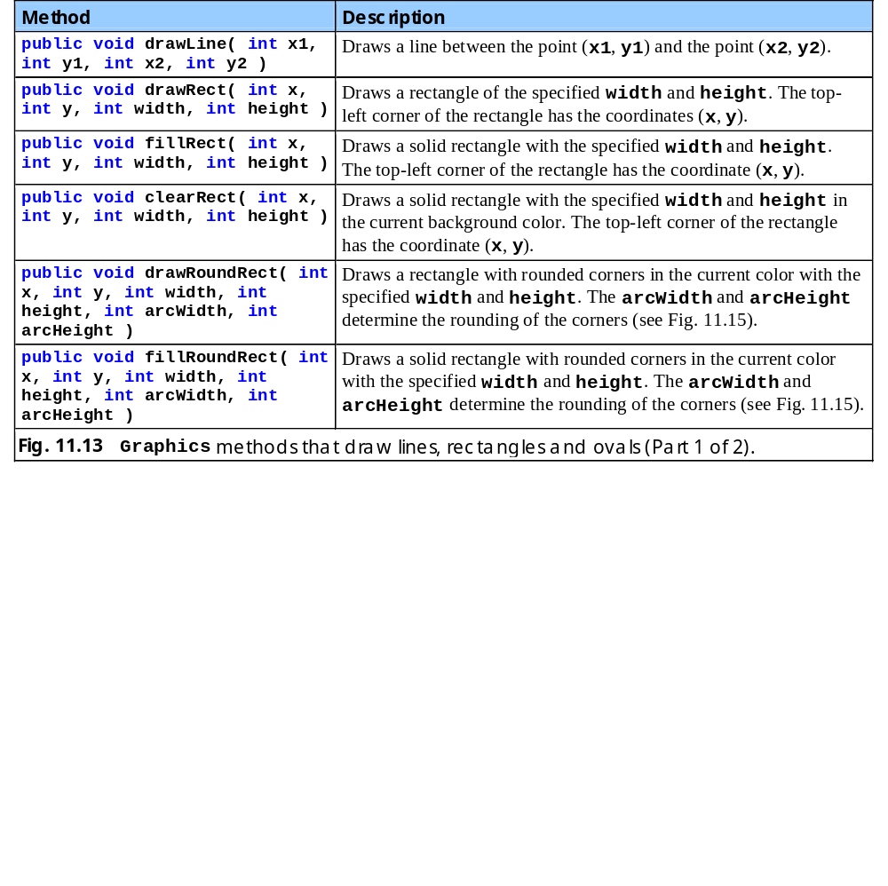
Fig. 11.13 Graphics methods that draw lines, rectangle and ovals.

Slide 28
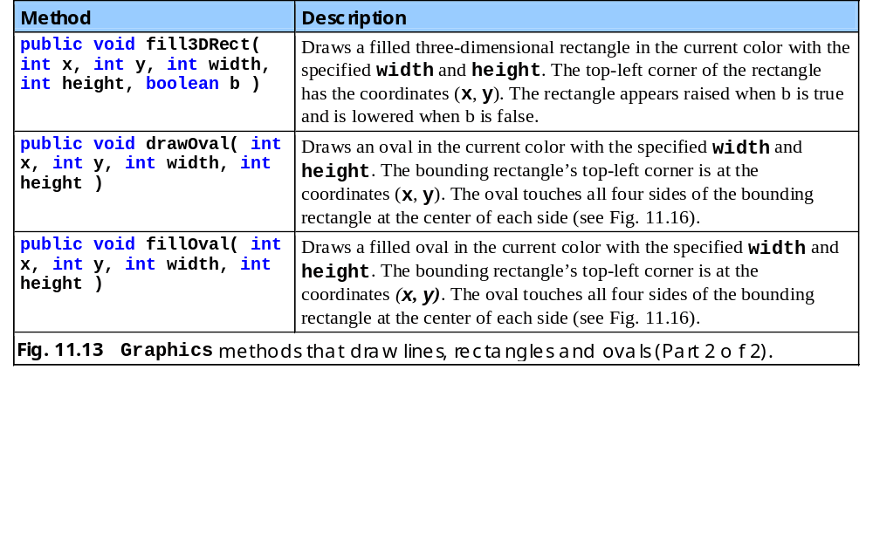
Fig. 11.13 Graphics methods that draw lines, rectangle and ovals (Part 2).

Slide 29
1 // Fig. 11.14: LinesRectsOvals.java
2 // Drawing lines, rectangles and ovals
3
4 // Java core packages
5 import java.awt.*;
6 import java.awt.event.*;
7
8 // Java extension packages
9 import javax.swing.*;
10
11 public class LinesRectsOvals extends JFrame {
12
13 // set window's title bar String and dimensions
14 public LinesRectsOvals()
15 {
16 super( "Drawing lines, rectangles and ovals" );
17
18 setSize( 400, 165 );
19 setVisible( true );
20 }
21
22 // display various lines, rectangles and ovals
23 public void paint( Graphics g )
24 {
25 // call superclass's paint method
26 super.paint( g );
27
28 g.setColor( Color.red );
29 g.drawLine( 5, 30, 350, 30 );
30
31 g.setColor( Color.blue );
32 g.drawRect( 5, 40, 90, 55 );
33 g.fillRect( 100, 40, 90, 55 );
34
35 g.setColor( Color.cyan );
LinesRectsOvals.java

Slide 30
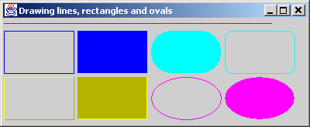
36 g.fillRoundRect( 195, 40, 90, 55, 50, 50 );
37 g.drawRoundRect( 290, 40, 90, 55, 20, 20 );
38
39 g.setColor( Color.yellow );
40 g.draw3DRect( 5, 100, 90, 55, true );
41 g.fill3DRect( 100, 100, 90, 55, false );
42
43 g.setColor( Color.magenta );
44 g.drawOval( 195, 100, 90, 55 );
45 g.fillOval( 290, 100, 90, 55 );
46 }
47
48 // execute application
49 public static void main( String args[] )
50 {
51 LinesRectsOvals application = new LinesRectsOvals();
52
53 application.setDefaultCloseOperation(
54 JFrame.EXIT_ON_CLOSE );
55 }
56
57 } // end class LinesRectsOvals
Draw filled rounded rectangle
Draw (non-filled) rounded rectangle
Draw 3D rectangle
LinesRectsOvals.java
Line 36
Line 37
Line 40
Line 41
Line 44
Line 45
Draw filled 3D rectangle
Draw oval
Draw filled oval

Slide 31
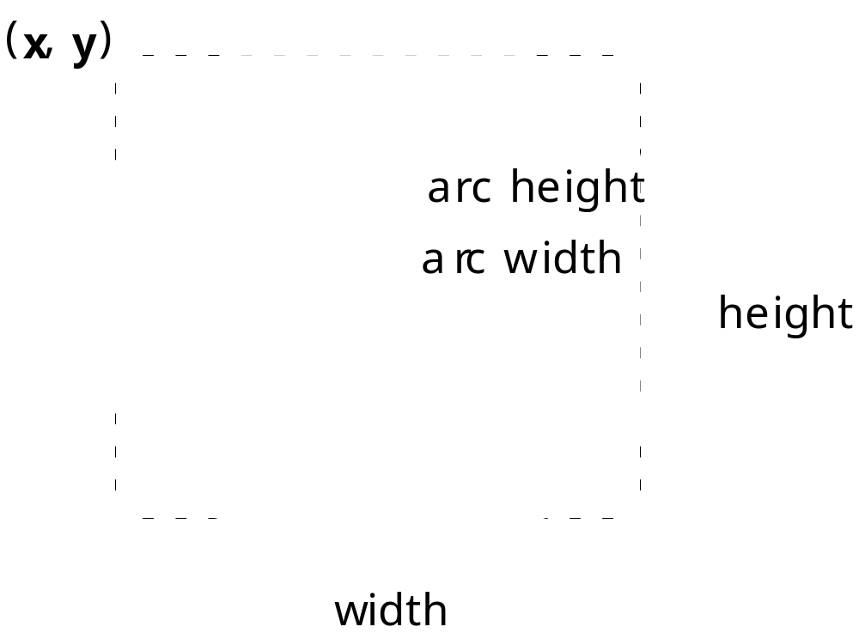
Fig. 11.15 The arc width and height for rounded rectangles.

Slide 32
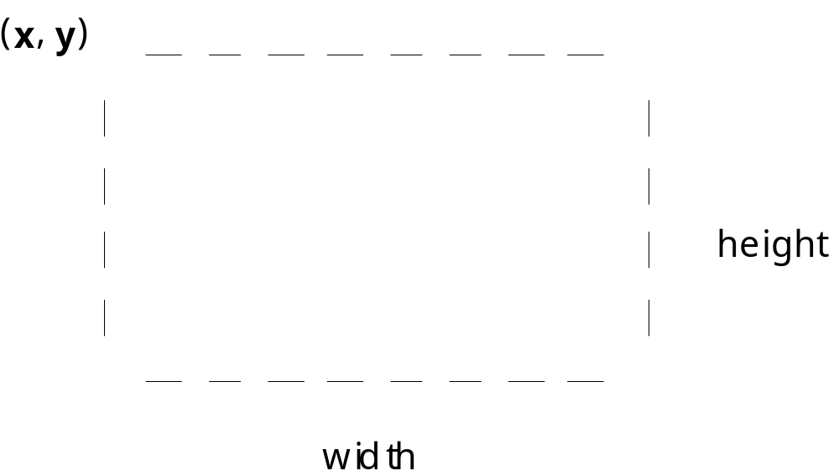
Fig. 11.16 An oval bounded by a rectangle.

Slide 33
11.6 Drawing Arcs
Arc
  Portion of oval
  Measured in degrees
  Sweeps the number of degrees in arc angle
  Sweep starts at starting angle
    Counterclockwise sweep is measure in positive degrees
    Clockwise sweep is measure in negative degrees

Slide 34
Fig. 11.17 Positive and negative arc angles.
Positive angles
Negative angles
90°
90°
180°
0°
180°
0°
270°
270°

Slide 35
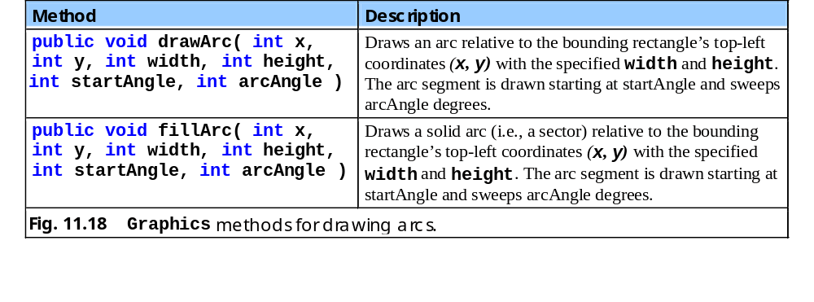
11.18 Graphics methods for drawing arcs.

Slide 36
1 // Fig. 11.19: DrawArcs.java
2 // Drawing arcs
3
4 // Java core packages
5 import java.awt.*;
6 import java.awt.event.*;
7
8 // Java extension packages
9 import javax.swing.*;
10
11 public class DrawArcs extends JFrame {
12
13 // set window's title bar String and dimensions
14 public DrawArcs()
15 {
16 super( "Drawing Arcs" );
17
18 setSize( 300, 170 );
19 setVisible( true );
20 }
21
22 // draw rectangles and arcs
23 public void paint( Graphics g )
24 {
25 // call superclass's paint method
26 super.paint( g );
27
28 // start at 0 and sweep 360 degrees
29 g.setColor( Color.yellow );
30 g.drawRect( 15, 35, 80, 80 );
31 g.setColor( Color.black );
32 g.drawArc( 15, 35, 80, 80, 0, 360 );
33
34 // start at 0 and sweep 110 degrees
35 g.setColor( Color.yellow );
DrawArcs.java
Lines 29-32
Draw first arc that sweeps 360 degrees and is contained in rectangle

Slide 37
36 g.drawRect( 100, 35, 80, 80 );
37 g.setColor( Color.black );
38 g.drawArc( 100, 35, 80, 80, 0, 110 );
39
40 // start at 0 and sweep -270 degrees
41 g.setColor( Color.yellow );
42 g.drawRect( 185, 35, 80, 80 );
43 g.setColor( Color.black );
44 g.drawArc( 185, 35, 80, 80, 0, -270 );
45
46 // start at 0 and sweep 360 degrees
47 g.fillArc( 15, 120, 80, 40, 0, 360 );
48
49 // start at 270 and sweep -90 degrees
50 g.fillArc( 100, 120, 80, 40, 270, -90 );
51
52 // start at 0 and sweep -270 degrees
53 g.fillArc( 185, 120, 80, 40, 0, -270 );
54 }
55
56 // execute application
57 public static void main( String args[] )
58 {
59 DrawArcs application = new DrawArcs();
60
61 application.setDefaultCloseOperation(
62 JFrame.EXIT_ON_CLOSE );
63 }
64
65 } // end class DrawArcs
Draw second arc that sweeps 110 degrees and is contained in rectangle
DrawArcs.java
Lines 35-38
Lines 41-44
Line 47
Line 50
Line 53
Draw third arc that sweeps -270 degrees and is contained in rectangle
Draw fourth arc that is filled, has starting angle 0 and sweeps 360 degrees
Draw fifth arc that is filled, has starting angle 270 and sweeps -90 degrees
Draw sixth arc that is filled, has starting angle 0 and sweeps -270 degrees

Slide 38
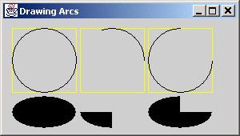
DrawArcs.java.
Output

Slide 39
11.7 Drawing Polygons and Polylines
Class Polygon
  Polygons
    Multisided shapes
  Polylines
    Series of connected points

Slide 40
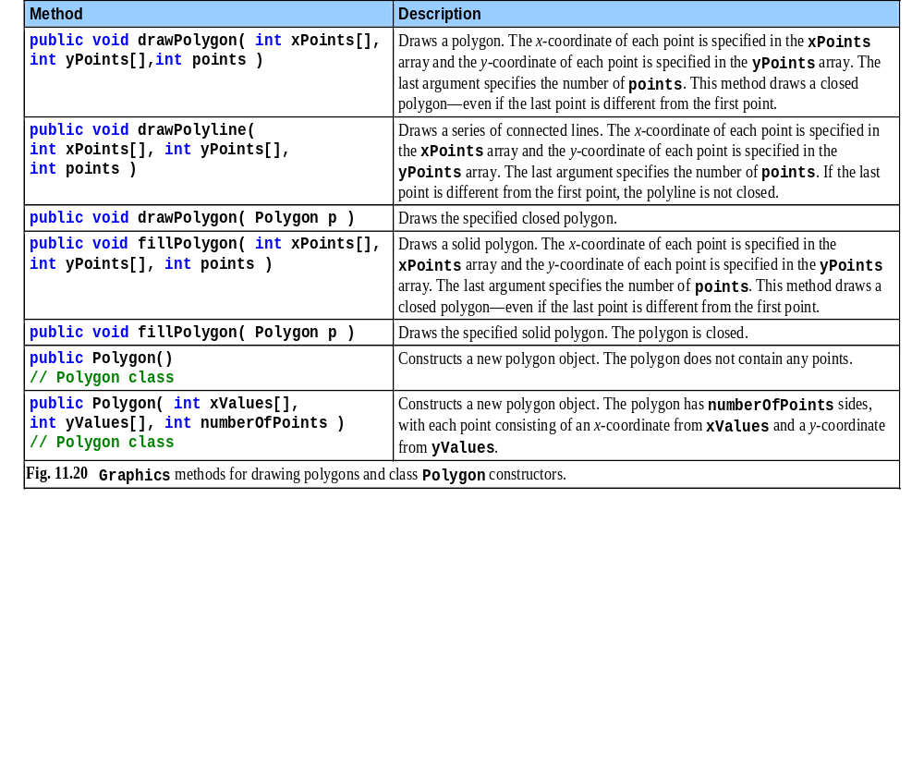
Fig. 11.20 Graphics methods for drawing polygons and class Polygon constructors

Slide 41
1 // Fig. 11.21: DrawPolygons.java
2 // Drawing polygons
3
4 // Java core packages
5 import java.awt.*;
6 import java.awt.event.*;
7
8 // Java extension packages
9 import javax.swing.*;
10
11 public class DrawPolygons extends JFrame {
12
13 // set window's title bar String and dimensions
14 public DrawPolygons()
15 {
16 super( "Drawing Polygons" );
17
18 setSize( 275, 230 );
19 setVisible( true );
20 }
21
22 // draw polygons and polylines
23 public void paint( Graphics g )
24 {
25 // call superclass's paint method
26 super.paint( g );
27
28 int xValues[] = { 20, 40, 50, 30, 20, 15 };
29 int yValues[] = { 50, 50, 60, 80, 80, 60 };
30 Polygon polygon1 = new Polygon( xValues, yValues, 6 );
31
32 g.drawPolygon( polygon1 );
33
34 int xValues2[] = { 70, 90, 100, 80, 70, 65, 60 };
35 int yValues2[] = { 100, 100, 110, 110, 130, 110, 90 };
DrawPolygons.java
Lines 28-29
Line 32
Lines 34-35
int arrays specifying Polygon polygon1 points
Draw polygon1 to screen
int arrays specifying Polygon polygon2 points

Slide 42
36
37 g.drawPolyline( xValues2, yValues2, 7 );
38
39 int xValues3[] = { 120, 140, 150, 190 };
40 int yValues3[] = { 40, 70, 80, 60 };
41
42 g.fillPolygon( xValues3, yValues3, 4 );
43
44 Polygon polygon2 = new Polygon();
45 polygon2.addPoint( 165, 135 );
46 polygon2.addPoint( 175, 150 );
47 polygon2.addPoint( 270, 200 );
48 polygon2.addPoint( 200, 220 );
49 polygon2.addPoint( 130, 180 );
50
51 g.fillPolygon( polygon2 );
52 }
53
54 // execute application
55 public static void main( String args[] )
56 {
57 DrawPolygons application = new DrawPolygons();
58
59 application.setDefaultCloseOperation(
60 JFrame.EXIT_ON_CLOSE );
61 }
62
63 } // end class DrawPolygons
Draw polygon2 to screen
DrawPolygons.java
Line 37
Lines 39-42
Lines 45-49
Specify Polygon points and draw (filled) polygon3 to screen
Method addPoint adds pairs of x-y coordinates to Polygon

Slide 43
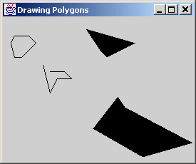
DrawPolygons.java
Output

Slide 44
11.8 Java 2D API
Java 2D API
  Provides advanced 2D graphics capabilities
    java.awt
    java.awt.image
    java.awt.color
    java.awt.font.geom
    java.awt.print
    java.awt.image.renderable
  Uses class java.awt.Graphics2D
    Extends class java.awt.Graphics

Slide 45
11.9 Java 2D Shapes
Java 2D shapes
  Package java.awt.geom
    Ellipse2D.Double
    Rectangle2D.Double
    RoundRectangle2D.Double
    Arc3D.Double
    Lines2D.Double

Slide 46
1 // Fig. 11.22: Shapes.java
2 // Demonstrating some Java2D shapes
3
4 // Java core packages
5 import java.awt.*;
6 import java.awt.event.*;
7 import java.awt.geom.*;
8 import java.awt.image.*;
9
10 // Java extension packages
11 import javax.swing.*;
12
13 public class Shapes extends JFrame {
14
15 // set window's title bar String and dimensions
16 public Shapes()
17 {
18 super( "Drawing 2D shapes" );
19
20 setSize( 425, 160 );
21 setVisible( true );
22 }
23
24 // draw shapes with Java2D API
25 public void paint( Graphics g )
26 {
27 // call superclass's paint method
28 super.paint( g );
29
30 // create 2D by casting g to Graphics2D
31 Graphics2D g2d = ( Graphics2D ) g;
32
33 // draw 2D ellipse filled with a blue-yellow gradient
34 g2d.setPaint( new GradientPaint( 5, 30, Color.blue, 35,
35 100, Color.yellow, true ) );
Shapes.java
Lines 34-35
Use GradientPaint to fill shape with gradient

Slide 47
36 g2d.fill( new Ellipse2D.Double( 5, 30, 65, 100 ) );
37
38 // draw 2D rectangle in red
39 g2d.setPaint( Color.red );
40 g2d.setStroke( new BasicStroke( 10.0f ) );
41 g2d.draw( new Rectangle2D.Double( 80, 30, 65, 100 ) );
42
43 // draw 2D rounded rectangle with a buffered background
44 BufferedImage buffImage = new BufferedImage(
45 10, 10, BufferedImage.TYPE_INT_RGB );
46
47 Graphics2D gg = buffImage.createGraphics();
48 gg.setColor( Color.yellow ); // draw in yellow
49 gg.fillRect( 0, 0, 10, 10 ); // draw a filled rectangle
50 gg.setColor( Color.black ); // draw in black
51 gg.drawRect( 1, 1, 6, 6 ); // draw a rectangle
52 gg.setColor( Color.blue ); // draw in blue
53 gg.fillRect( 1, 1, 3, 3 ); // draw a filled rectangle
54 gg.setColor( Color.red ); // draw in red
55 gg.fillRect( 4, 4, 3, 3 ); // draw a filled rectangle
56
57 // paint buffImage onto the JFrame
58 g2d.setPaint( new TexturePaint(
59 buffImage, new Rectangle( 10, 10 ) ) );
60 g2d.fill( new RoundRectangle2D.Double(
61 155, 30, 75, 100, 50, 50 ) );
62
63 // draw 2D pie-shaped arc in white
64 g2d.setPaint( Color.white );
65 g2d.setStroke( new BasicStroke( 6.0f ) );
66 g2d.draw( new Arc2D.Double(
67 240, 30, 75, 100, 0, 270, Arc2D.PIE ) );
68
69 // draw 2D lines in green and yellow
70 g2d.setPaint( Color.green );
Fill ellipse with gradient
Use BasicStroke to draw 2D red-border rectangle
Shapes.java
Line 36
Lines 40-41
Lines 44-45
Lines 47-55
Lines 58-61
Lines 64-67
BufferedImage produces image to be manipulated
Draw texture into BufferedImage
Use BufferedImage as texture for painting rounded rectangle
Use Arc2D.PIE to draw white-border 2D pie-shaped arc

Slide 48
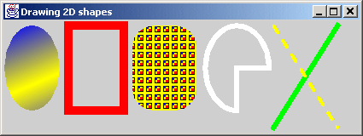
71 g2d.draw( new Line2D.Double( 395, 30, 320, 150 ) );
72
73 float dashes[] = { 10 };
74
75 g2d.setPaint( Color.yellow );
76 g2d.setStroke( new BasicStroke( 4, BasicStroke.CAP_ROUND,
77 BasicStroke.JOIN_ROUND, 10, dashes, 0 ) );
78 g2d.draw( new Line2D.Double( 320, 30, 395, 150 ) );
79 }
80
81 // execute application
82 public static void main( String args[] )
83 {
84 Shapes application = new Shapes();
85
86 application.setDefaultCloseOperation(
87 JFrame.EXIT_ON_CLOSE );
88 }
89
90 } // end class Shapes
Draw solid green line
Shapes.java
Line 71
Lines 75-78
Draw dashed yellow line that crosses solid green line

Slide 49
1 // Fig. 11.23: Shapes2.java
2 // Demonstrating a general path
3
4 // Java core packages
5 import java.awt.*;
6 import java.awt.event.*;
7 import java.awt.geom.*;
8
9 // Java extension packages
10 import javax.swing.*;
11
12 public class Shapes2 extends JFrame {
13
14 // set window's title bar String, background color
15 // and dimensions
16 public Shapes2()
17 {
18 super( "Drawing 2D Shapes" );
19
20 getContentPane().setBackground( Color.yellow );
21 setSize( 400, 400 );
22 setVisible( true );
23 }
24
25 // draw general paths
26 public void paint( Graphics g )
27 {
28 // call superclass's paint method
29 super.paint( g );
30
31 int xPoints[] =
32 { 55, 67, 109, 73, 83, 55, 27, 37, 1, 43 };
33 int yPoints[] =
34 { 0, 36, 36, 54, 96, 72, 96, 54, 36, 36 };
35
Shapes2.java
Lines 31-34
x-y coordinates that comprise star

Slide 50
36 Graphics2D g2d = ( Graphics2D ) g;
37
38 // create a star from a series of points
39 GeneralPath star = new GeneralPath();
40
41 // set the initial coordinate of the General Path
42 star.moveTo( xPoints[ 0 ], yPoints[ 0 ] );
43
44 // create the star--this does not draw the star
45 for ( int count = 1; count < xPoints.length; count++ )
46 star.lineTo( xPoints[ count ], yPoints[ count ] );
47
48 // close the shape
49 star.closePath();
50
51 // translate the origin to (200, 200)
52 g2d.translate( 200, 200 );
53
54 // rotate around origin and draw stars in random colors
55 for ( int count = 1; count <= 20; count++ ) {
56
57 // rotate coordinate system
58 g2d.rotate( Math.PI / 10.0 );
59
60 // set random drawing color
61 g2d.setColor( new Color(
62 ( int ) ( Math.random() * 256 ),
63 ( int ) ( Math.random() * 256 ),
64 ( int ) ( Math.random() * 256 ) ) );
65
66 // draw filled star
67 g2d.fill( star );
68 }
69
70 } // end method paint
GeneralPath is a shape constructed from straight lines and complex curves
Shapes2.java
Line 39
Lines 42-49
Lines 55-67
Create star
Draw filled, randomly colored star 20 times around origin

Slide 51
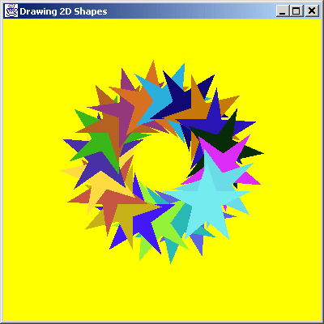
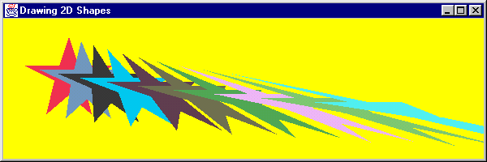
71
72 // execute application
73 public static void main( String args[] )
74 {
75 Shapes2 application = new Shapes2();
76
77 application.setDefaultCloseOperation(
78 JFrame.EXIT_ON_CLOSE );
79 }
80
81 } // end class Shapes2
Shapes2.java

Slide 52
11.10 (Optional Case Study) Thinking About Objects: Designing Interfaces With the UML
Use UML to represent listener interfaces
  Class diagram modeling realizations
    Classes realize, or implement, interface behaviors
    Person realizes DoorListener
    In Java, class Person implements interface DoorListener

Slide 53
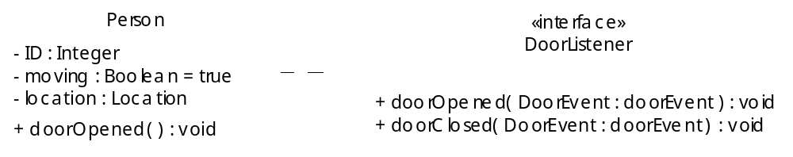
Fig. 11.25 Class diagram that models class Person realizing interface DoorListener.

Slide 54
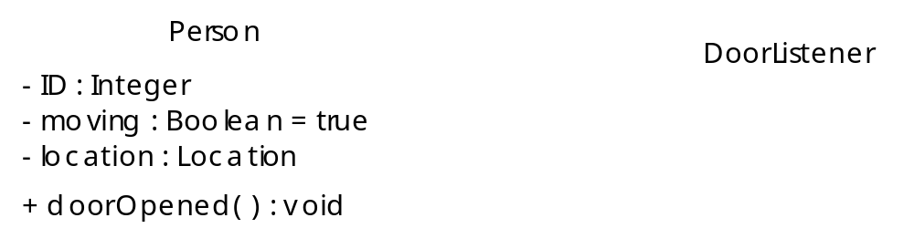
Fig. 11.26 Elided class diagram that models class Person realizing interface DoorListener

Slide 55
1 // Person.java
2 // Generated from Fig. 11.24
3 public class Person implements DoorListener {
4
5 // attributes
6 private int ID;
7 private boolean moving = true;
8 private Location location;
9
10 // constructor
11 public Person() {}
12
13 // methods of DoorListener
14 public void doorOpened( DoorEvent doorEvent ) {}
15 public void doorClosed( DoorEvent doorEvent ) {}
16 }
Person.java
Lines 3 and 14-15
Class Person must implement DoorListener methods

Slide 56
Fig. 11.27 Class diagram that models realizations in the elevator model.
PersonMoveListener
ButtonListener
DoorListener
BellListener
ElevatorModel
Elevator
LightListener
ButtonListener
DoorListener
DoorListener
ElevatorShaft
Person
ElevatorMoveListener
Door
Light
Bell
Button

Slide 57
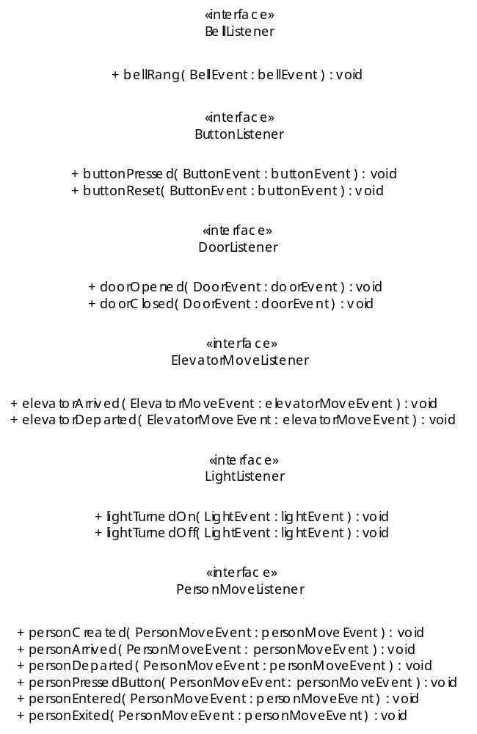
Fig. 11.28 Class diagram for listener interfaces

